Slide 1

Geometry
Unit 12, Lesson 1 Solving Problems with Lengths of Intersecting Chords Volume 2, pg. 231

Slide 2


Benchmark
MA.912.GR.6.1
Solve mathematical and real-world problems involving the length of a secant, tangent, segment, or chord in a given circle.
volume 2, pg. 231

Slide 3
Integrated Mathematical Thinking and Reasoning Standards
MA.K12.MTR.1.1 Actively participate in effortful learning both individually and collectively.
MA.K12.MTR.2.1 Demonstrate understanding by representing problems in multiple ways.
MA.K12.MTR.4.1 Engage in discussions that reflect on the mathematical thinking of self and others.
MA.K12.MTR.5.1 Use patterns and structure to help understand and connect mathematical concepts.
MA.K12.MTR.6.1 Assess the reasonableness of solutions.
volume 2, pg. 231

Slide 4

Learning Target
I can solve mathematical and real-world problems involving lengths formed by the intersection of two chords.
volume 2, pg. 231

Slide 5

Warm-Up
volume 2, pg. 231

Slide 6
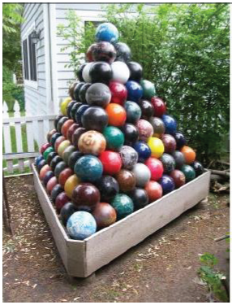
12.1.1 Warm-Up: Notice and Wonder
A picture of a bowling ball pyramid is shown.
What do you wonder?
What do you notice?
Write a question about the pyramid that a 5th grader could answer.
volume 2, pg. 231

Slide 7

Exploration
volume 2, pg. 232

Slide 8

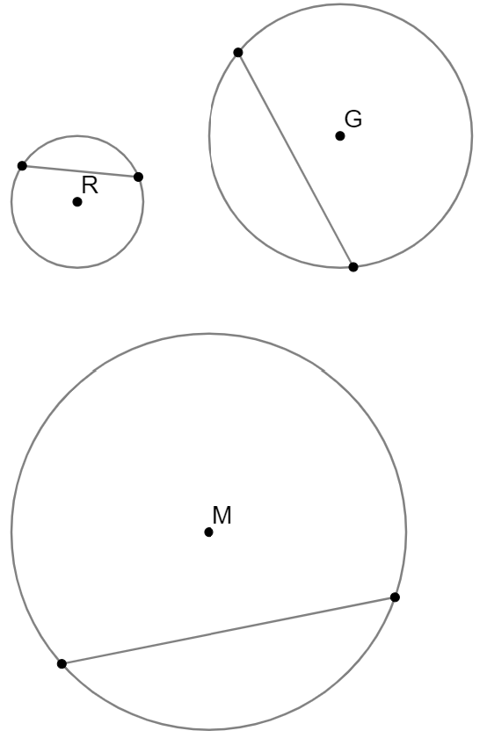
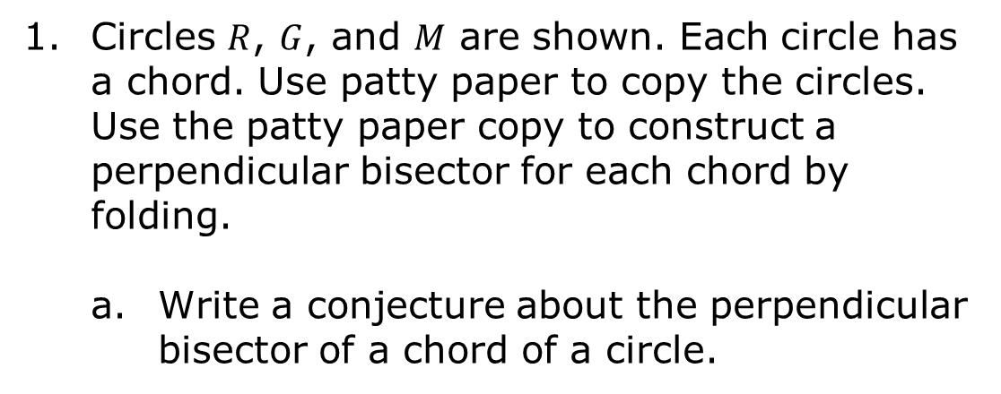
12.1.2 Exploration: Chords
Circles $R$, $G$, and $M$ are shown. Each circle has a chord. Use patty paper to copy the circles. Use the patty paper copy to construct a perpendicular bisector for each chord by folding.
Write a conjecture about the perpendicular bisector of a chord of a circle.
volume 2, pg. 232

Slide 9
Share your conjecture with your partner. Listen to your partner’s conjecture and write a summary. Have your partner initial that it is summarized correctly.
Review your conjecture and make any revisions, if needed.
Summary of Partner’s Conjecture | Partner’s Initials
volume 2, pg. 232

Slide 10
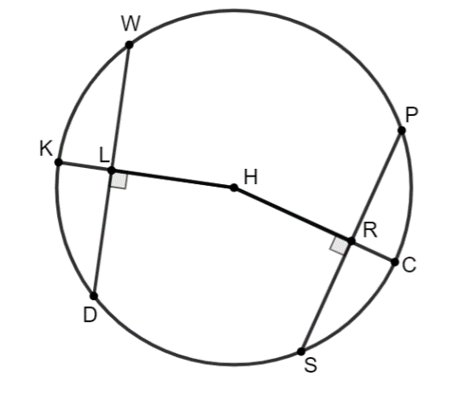
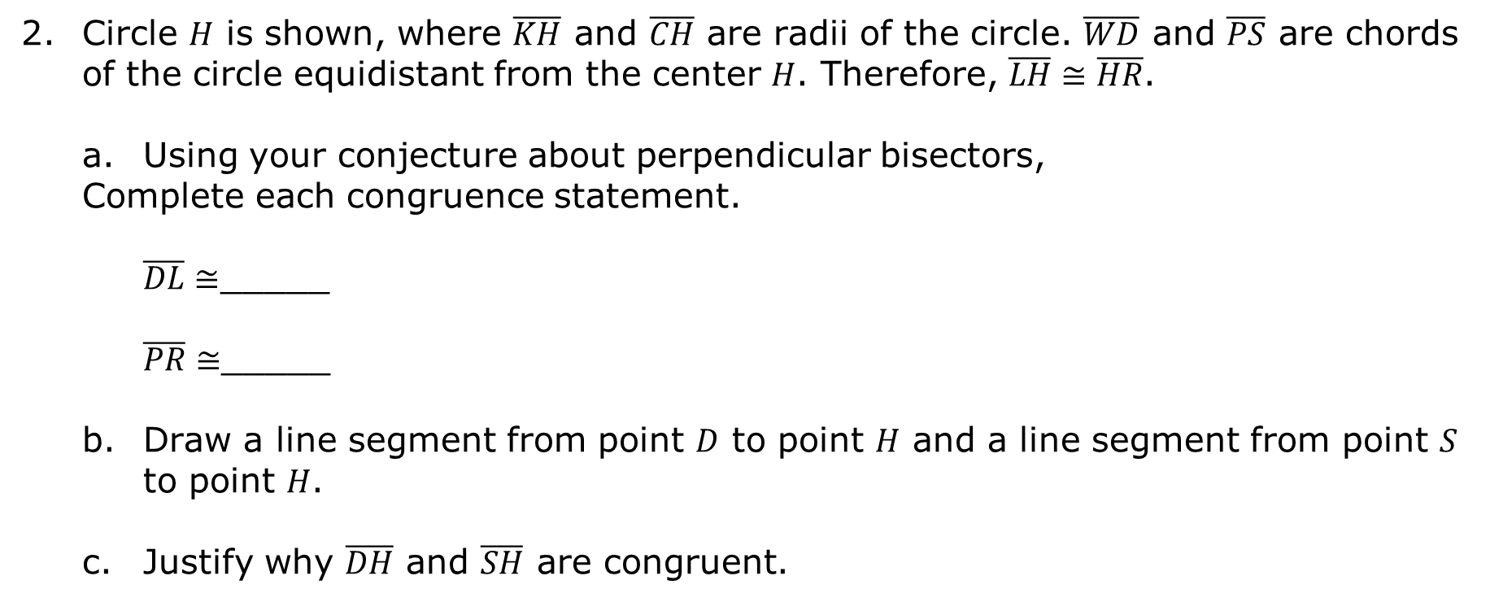
Circle $H$ is shown, where $\overline{KH}$ and $\overline{CH}$ are radii of the circle. $\overline{WD}$ and $\overline{PS}$ are chords of the circle equidistant from the center $H$. Therefore, $\overline{LH}≅\overline{HR}$.
Using your conjecture about perpendicular bisectors,
Complete each congruence statement.
$\overline{DL}≅$_____
$\overline{PR}≅$_____
Draw a line segment from point $D$ to point $H$ and a line segment from point $S$ to point $H$.
Justify why $\overline{DH}$ and $\overline{SH}$ are congruent.
volume 2, pg. 233

Slide 11
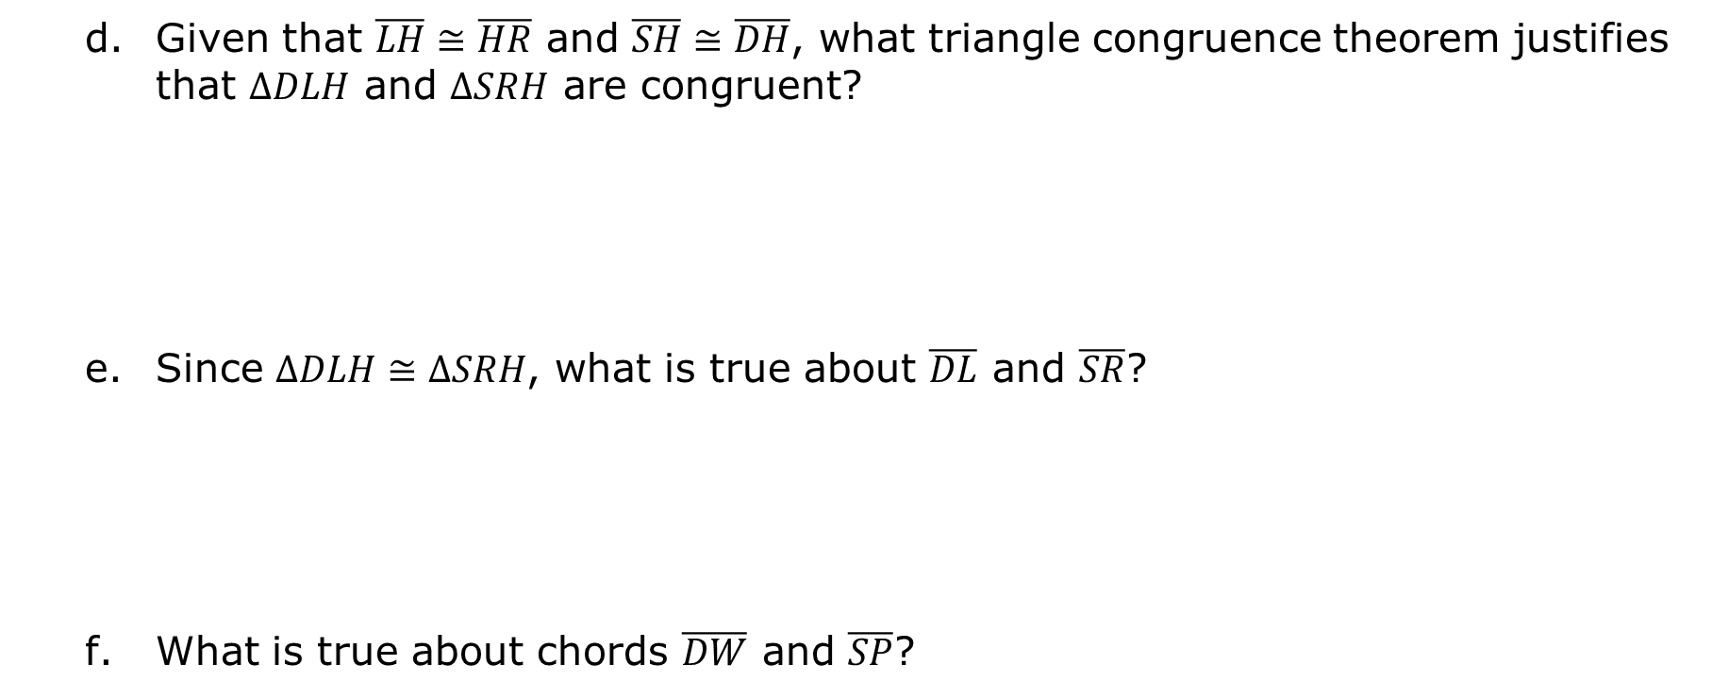
Given that $\overline{LH}≅\overline{HR}$ and $\overline{SH}≅\overline{DH}$, what triangle congruence theorem justifies that $∆DLH$ and $∆SRH$ are congruent?
Since $∆DLH≅∆SRH$, what is true about $\overline{DL}$ and $\overline{SR}$?
What is true about chords $\overline{DW}$ and $\overline{SP}$?
volume 2, pg. 233

Slide 12
Circle $Y$ is shown, where points $C$, $P$, $K$, and $B$ are on circle $Y$. Chords $PB$ and $KC$ intersect at point $M$.
volume 2, pg. 234

Slide 13
Observations of the Blue Chord Measures | Observations of the Green Chord Measures
Commonalities in the Blue and Green Chords
What do you wonder about the relationship between the blue chord and the green chord?
volume 2, pg. 234

Slide 14

Bring It Together
volume 2, pg. 234

Slide 15

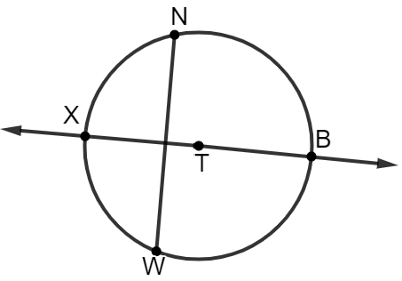

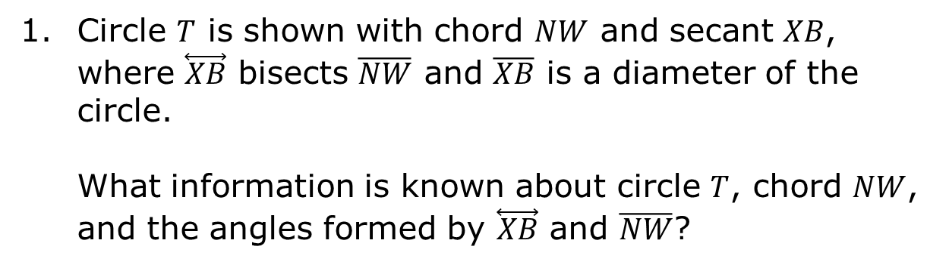
12.1.3 Bring It Together: Chord Relationships
Circle $T$ is shown with chord $NW$ and secant $XB$, where $\overset{⃡}{XB}$ bisects $\overline{NW}$ and $\overline{XB}$ is a diameter of the circle.
What information is known about circle $T$, chord $NW$, and the angles formed by $\overset{⃡}{XB}$ and $\overline{NW}$?
If a diameter of a circle is perpendicular to a chord, then the diameter bisects the chord and its arc.
volume 2, pg. 234

Slide 16
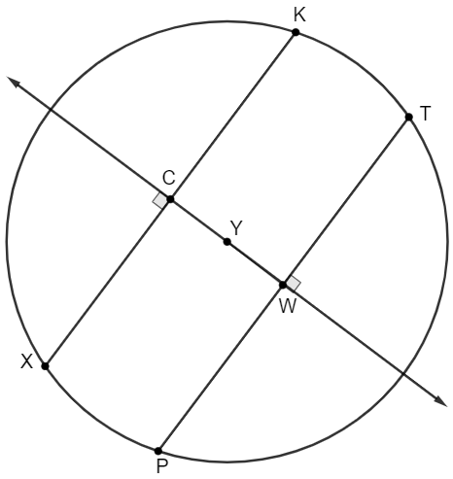
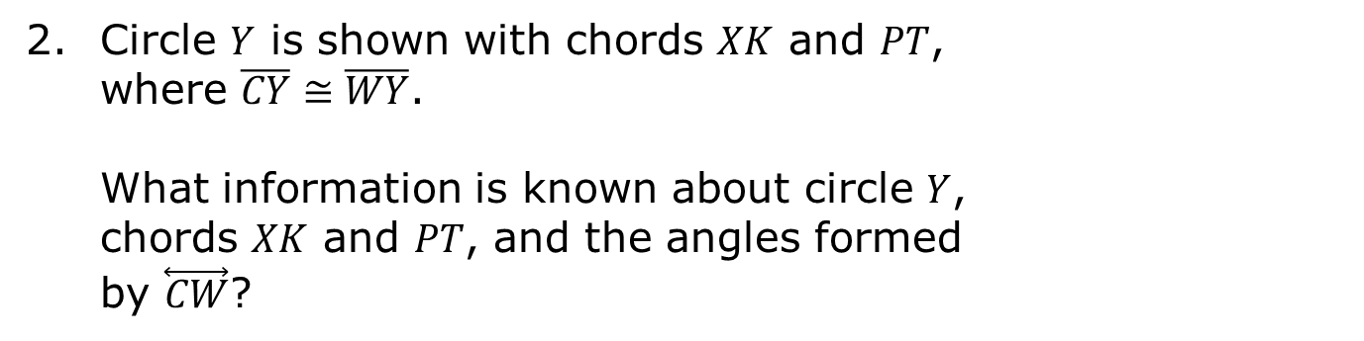
Circle $Y$ is shown with chords $XK$ and $PT$, where $\overline{CY}≅\overline{WY}$.
What information is known about circle $Y$,
chords $XK$ and $PT$, and the angles formed
by $\overset{⃡}{CW}$?
If two chords are equidistant from the center of a circle, then the chords are congruent.
volume 2, pg. 235

Slide 17
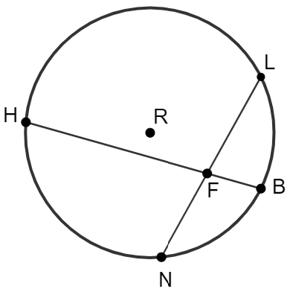
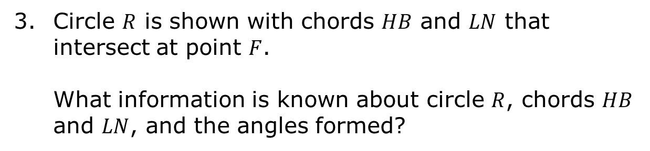
Circle $R$ is shown with chords $HB$ and $LN$ that intersect at point $F$.
What information is known about circle $R$, chords $HB$ and $LN$, and the angles formed?
When two chords intersect each other inside a circle, the products of their segments are equal.
volume 2, pg. 235

Slide 18

Guided Practice
volume 2, pg. 236

Slide 19

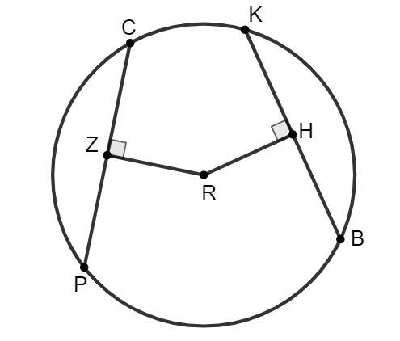
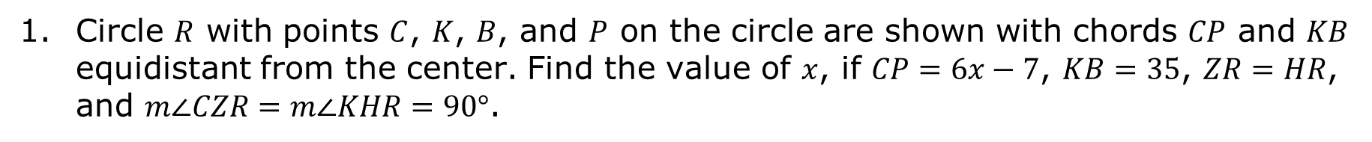
12.1.4 Guided Practice: Solving Problems Involving Intersecting Chords
Circle $R$ with points $C$, $K$, $B$, and $P$ on the circle are shown with chords $CP$ and $KB$ equidistant from the center. Find the value of $x$, if $CP=6x−7$, $KB=35$, $ZR=HR$, and $m∠CZR=m∠KHR=90°$.
volume 2, pg. 236

Slide 20
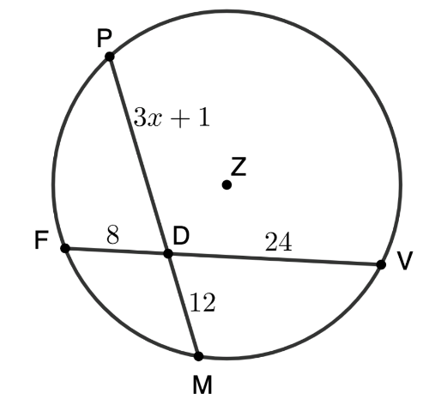
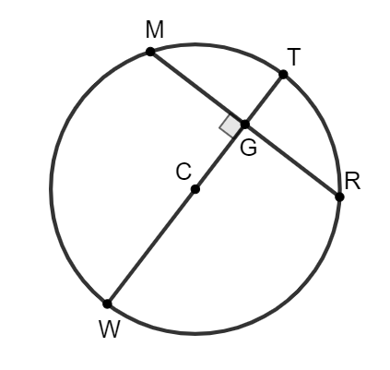
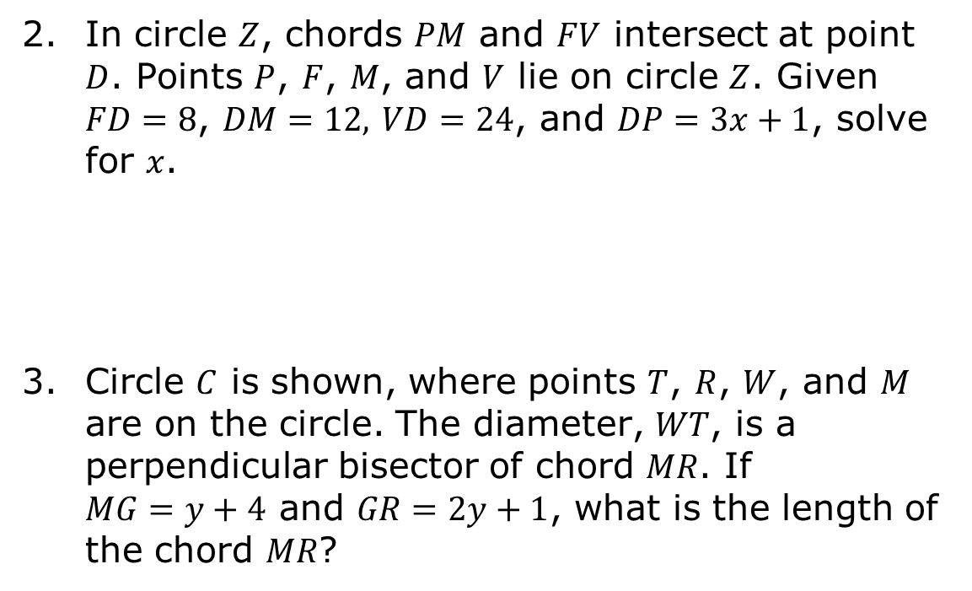
In circle $Z$, chords $PM$ and $FV$ intersect at point $D$. Points $P$, $F$, $M$, and $V$ lie on circle $Z$. Given $FD=8$, $DM=12,$ $VD=24$, and $DP=3x+1$, solve for $x$.
Circle $C$ is shown, where points $T$, $R$, $W$, and $M$ are on the circle. The diameter, $WT$, is a perpendicular bisector of chord $MR$. If $MG=y+4$ and $GR=2y+1$, what is the length of the chord $MR$?
volume 2, pg. 236

Slide 21

Wrap-Up
volume 2, pg. 237

Slide 22
12.1.5 Wrap-Up: Reflection
Draw an X on each line to indicate how you feel about solving problems involving chords.
I can use the proportional relationship between the measures of segments formed by intersecting chords to solve problems.
I need help. I can’t get started. | I’m getting there, but I need more practice. | I understand this and I feel confident.
volume 2, pg. 237

Slide 23
I can demonstrate that chords are congruent, if the two chords are equidistant from the center of a circle.
I can show that if a diameter of a circle is perpendicular to a chord, then the diameter bisects the chord.
I need help. I can’t get started. | I’m getting there, but I need more practice. | I understand this and I feel confident.
I need help. I can’t get started. | I’m getting there, but I need more practice. | I understand this and I feel confident.
volume 2, pg. 237

